Slide 1

Applied Physics
(Computer Science Department)
Lecture – 01
Introduction and
Coulomb’s Law
By: Engr. Asif Ali
Lecture – 01
Engr. Asif Ali

Slide 2
Agenda
Theory Outline
Basics of Physics
Electric Charge
Conductors and Insulators
Coulomb’s Law
Lecture – 01

Slide 3
Theory Outline
Session No | Week | Topics | Assignments / Quizzes / Digital Library Work | Suggested Readings
01-06 | 03 | Series Parallel Resistors & Capacitors, Voltage Divider, Current Divider Electric Current, energy transfer in an electric circuit. Use of Kirchhoff's Ist & 2nd law, capacitance, dielectrics. Growth and Decay of voltage in an RC circuit. Solve numerical problems involving topics covered |  | Text Book [1]
Lecture – 01

Slide 4
Theory Outline
Session No | Week | Topics | Assignments / Quizzes / Digital Library Work | Suggested Readings
7-21 | 04 | Electrostatics: Coulomb’s law, first and second shell theorems, Charge in isolated conductors, charge quantization, charge conservation Electric field and potential, Field due to a point charge: electric field of Dipole, Electric flux: Gauss's law; and its application, field near a charged conducting sheet, Field of infinite line of charge. Solve numerical problems involving topics covered | Quiz | Text Book [1]
Lecture – 01

Slide 5
Theory Outline
Session No | Week | Topics | Assignments / Quizzes / Digital Library Work | Suggested Readings
41-45 | 04 | Basic crystal structure, free electron model, energy band in solid and energy gaps, doping, p-type, n-type semiconductor materials, p-n junction diode, its structure. Characteristics curve of a diode, half wave rectification, and full wave rectification, peak inverse voltage in case of full wave rectifier, characteristics and application as rectifiers. Clipper and clamper circuits. Transistor, its basic structure and operation. Solve numerical problems | Quiz III | Text Book [2]
Lecture – 01

Slide 6
Theory Outline
Session No | Week | Topics | Assignments / Quizzes / Digital Library Work | Suggested Readings
29-34 | 03 | Electrodynamics: Magnetic field and force, sources of magnetic field, Magnetic force on a charged particle, magnetic force on a current, Torque on a current loop. Faradays law of electromagnetic induction, Lenz’s law, Magnetic dipole: Energy of magnetic dipole in field. RL circuit. Solve numerical problems involving topics covered | Quiz II | Text Book [1]
Lecture – 01

Slide 7
Marks Distribution
Mid-Term 30%
Sessional 20% ( Presentation, Assignment, Quizzes)
Final 50%

Slide 8

Physics ?

Slide 9
Applied Physics ?

Slide 10
Physics VS Applied Physics
Physics
Applied Physics
Physics is the fundamental study of the principles governing the natural world, exploring concepts such as motion, energy, and matter.
Physics studies matter, force, and energy, as well their interaction with the world.
Applied physics, on the other hand, focuses on the practical application of physical principles to solve real-world problems and develop technologies.
Applied Physics is physics which is intended for a particular technological or practical use.

Slide 11
Physics VS Applied Physics
Physics
Applied Physics
Uncover fundamental laws of the universe
Understanding the behavior of matter and energy.
Explaining nature phenomena, expanding scientific knowledge.
Apply physics principles to practical scenarios.
Utilize physics knowledge for problem-solving and practical applications.
Improving existing systems, solving real-world problems.

Slide 12
Importance of Applied Physics
Lecture – 01

Slide 13
Electromagnetism
?

Slide 14
What is Electromagnetism?
Electromagnetism is a branch of physics that studies the relationship between electric and magnetic fields, their interactions, and the phenomena they produce, such as electromagnetic waves and magnetic forces.

Slide 15
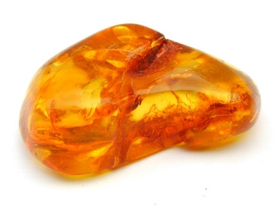

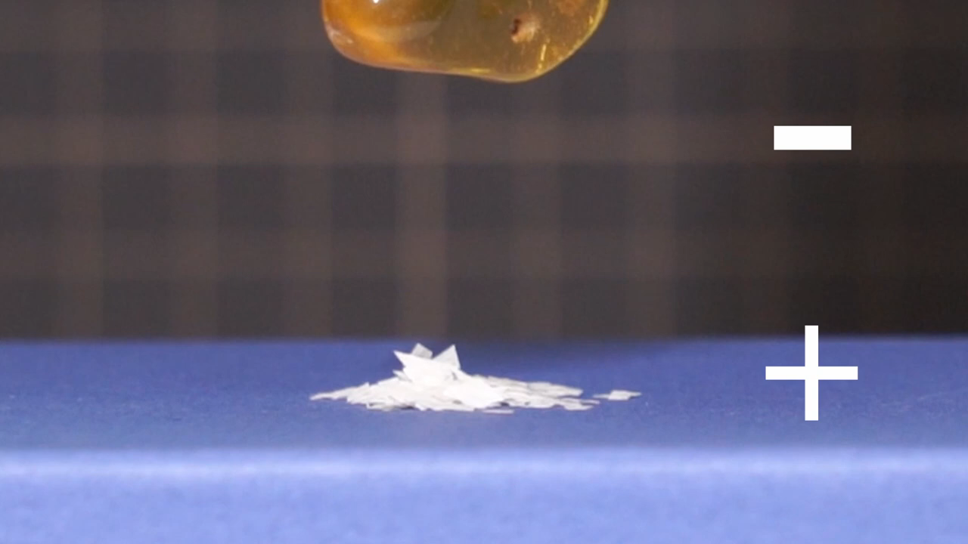
Basics of Physics
- Simple Experiment
The physics of electromagnetism was first studied by the early Greek philosophers, who discovered that if a piece of amber is rubbed and then brought near bits of straw, the straw will jump to the amber.
We now know that the attraction between amber and straw is due to an electric force.
Amber
Lecture – 01

Slide 16
Basics of Physics
The new science of electromagnetism was developed further by workers in many countries.
One of the best was Michael Faraday, a truly gifted experimenter with a talent for physical intuition and visualization.
That talent is attested to by the fact that his collected laboratory notebooks do not contain a single equation.
In the mid-nineteenth century, James Clerk Maxwell put Faraday’s ideas into mathematical form, introduced many new ideas of his own, and put electromagnetism on a sound theoretical basis.
Lecture – 01

Slide 17
Electric Charge
It is the basic property of matter carried by some elementary particles that governs how the particles are affected by an electric or magnetic field.
Electric charge could be positive or negative.
There are two types of charges positive and negative charge.
When two objects that have an excess of one type of charge exert a force of repulsion on each other when relatively close together.
Opposite charges will attract each other and same charges will repel each other.
Lecture – 01

Slide 18
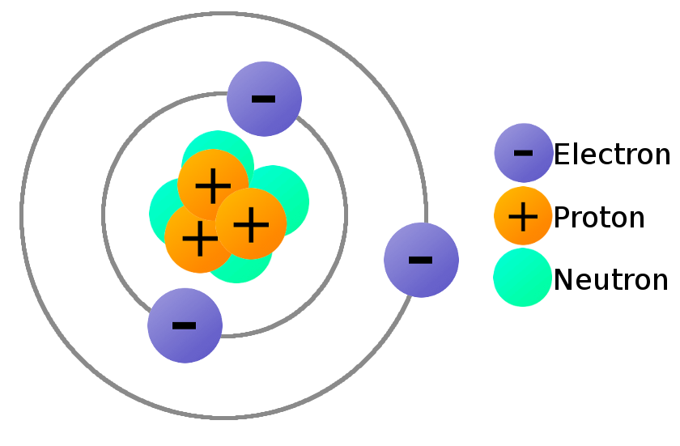
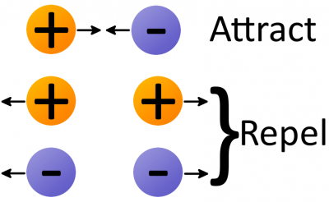
Electric Charge(s)
Lecture – 01

Slide 19
Conductors and Insulators
We can classify materials generally according to the ability of charge to move through them.
Conductors are materials through which charge can move rather freely;
Examples include metals (such as copper in common lamp wire), the human body, and tap water.
Nonconductors—also called insulators—are materials through which charge cannot move freely;
Examples include rubber (such as the insulation on common lamp wire), plastic, glass, and chemically pure water.
Semiconductors are materials that are intermediate between conductors and insulators; examples include silicon and germanium in computer chips.
Lecture – 01

Slide 20
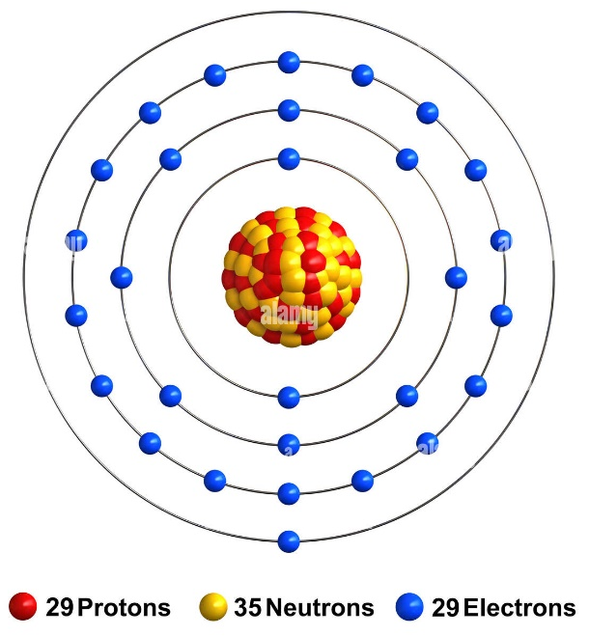
Conductors and Insulators
- Charged Particles
The properties of conductors and insulators are due to the structure and electrical nature of atoms.
Atoms consist of positively charged protons, negatively charged electrons, and electrically neutral neutrons.
The protons and neutrons are packed tightly together in a central nucleus.
The charge of a single electron and that of a single proton have the same magnitude but are opposite in sign.
Copper Atomic Structure
Hence, an electrically neutral atom contains equal numbers of electrons and protons.
Electrons are held near the nucleus because they have the electrical sign opposite that of the protons in the nucleus and thus are attracted to the nucleus.
Lecture – 01

Slide 21
Conductors and Insulators
- Charged Particles
When atoms of a conductor like copper come together to form the solid, some of their outermost (and so most loosely held) electrons become free to wander about within the solid, leaving behind positively charged atoms (positive ions).
We call the mobile electrons conduction electrons.
There are few (if any) free electrons in a nonconductor.
Copper Atomic Structure
Lecture – 01

Slide 22
Coulomb’s Law
Statement: The force of attraction or repulsion between two charged bodies is directly proportional to the product of their charges and inversely proportional to the square of the distance between them. It acts along the line joining the two charges considered to be point charges.
Lecture – 01

Slide 23
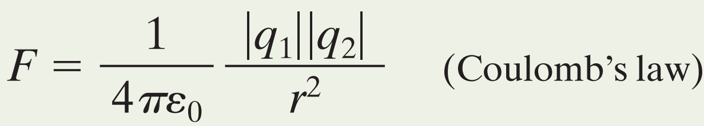
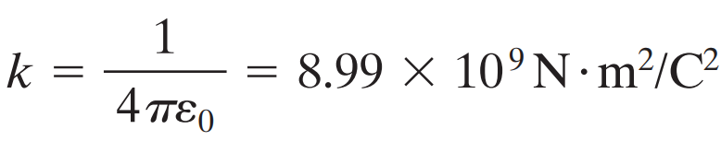
Coulomb’s Law
Unit. The SI unit of charge is the coulomb.
Force Magnitude. For historical reasons (and because doing so simplifies many other formulas), the electrostatic constant k in Eq. is often written as 1/4pε0,.
Then the magnitude of the electrostatic force in Coulomb’s law becomes
The constants have the value
Lecture – 01

Slide 24
Thank You
Lecture – 01

Slide 25
References
Amber and Straw experiment: https://www.youtube.com/watch?v=gxpl2J6EdIk
Magnetism simple experiment: https://www.youtube.com/watch?v=w_ZqTGxtHrk
Simple experiment on glass rod and silk: https://www.youtube.com/watch?v=iHBNWiHJaQQ

